Slide 1

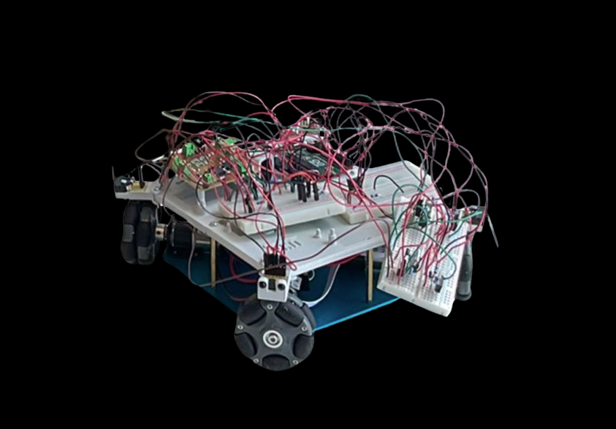
OPEN DAY ROBOTS
YOUR OPPORTUNITY TO LEARN ROBOTICS IN 90 MINS

Slide 2
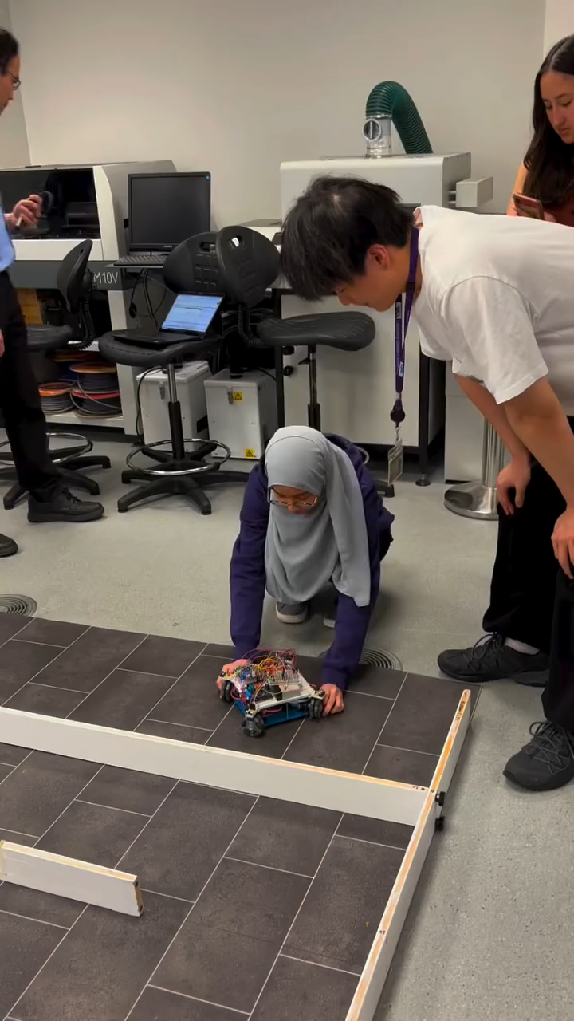

Slide 3
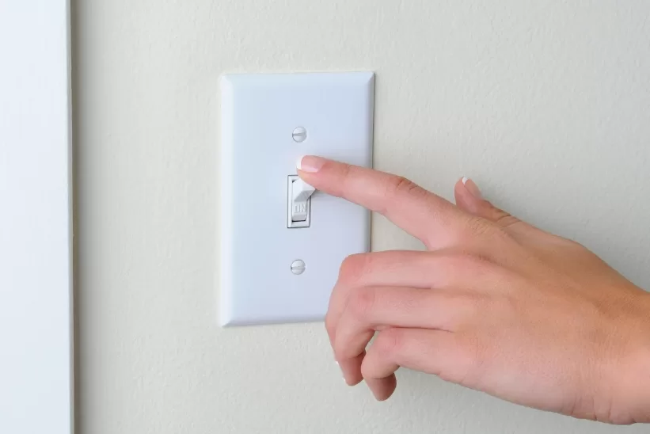

Slide 4
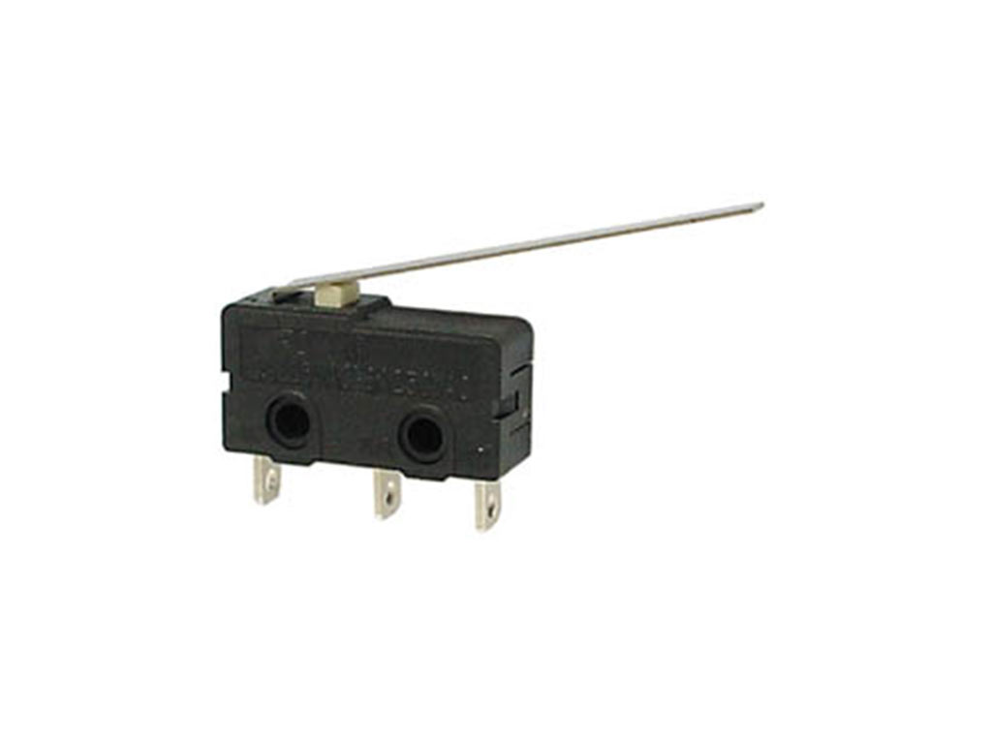

Slide 5
=

Slide 6
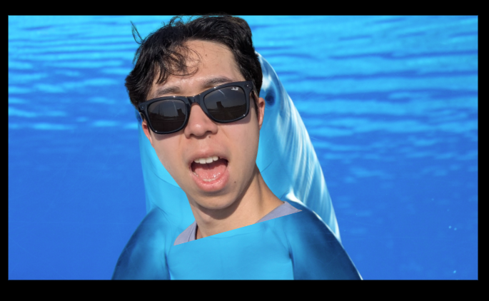
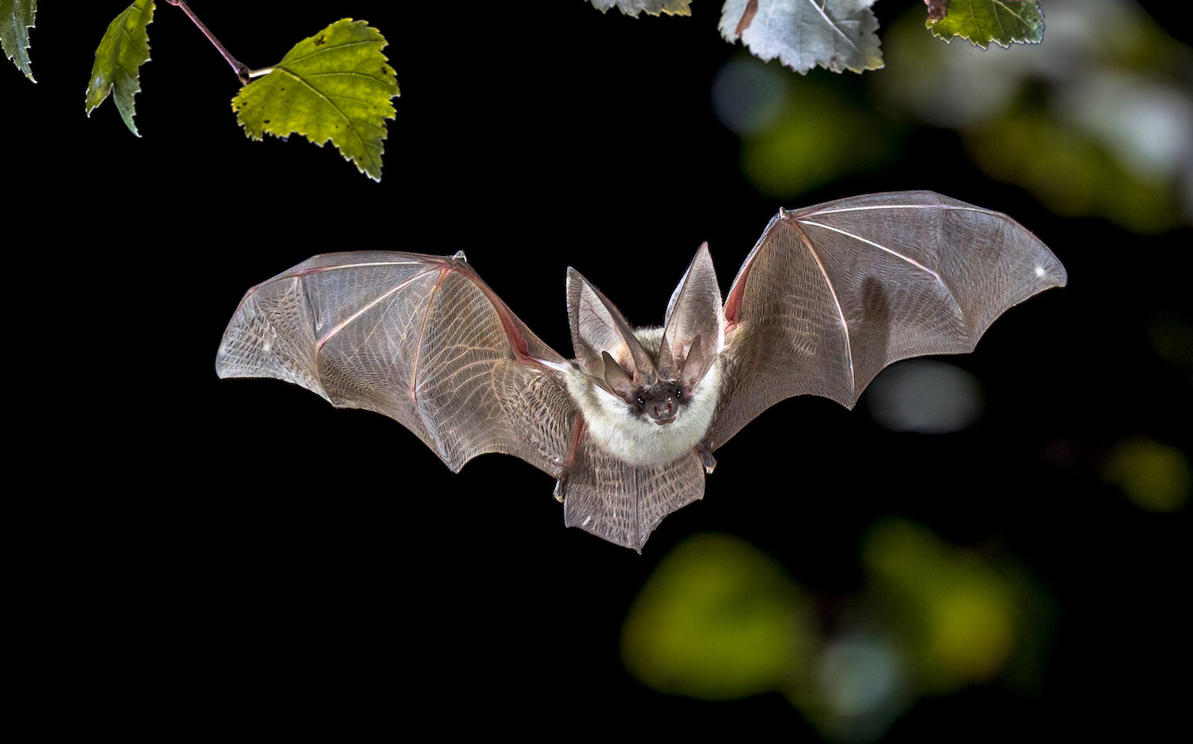

Slide 7
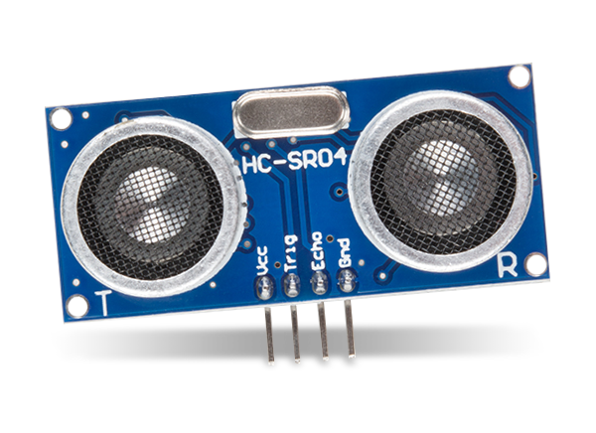


Slide 8
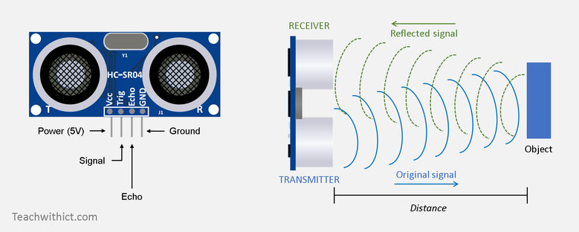

Slide 9
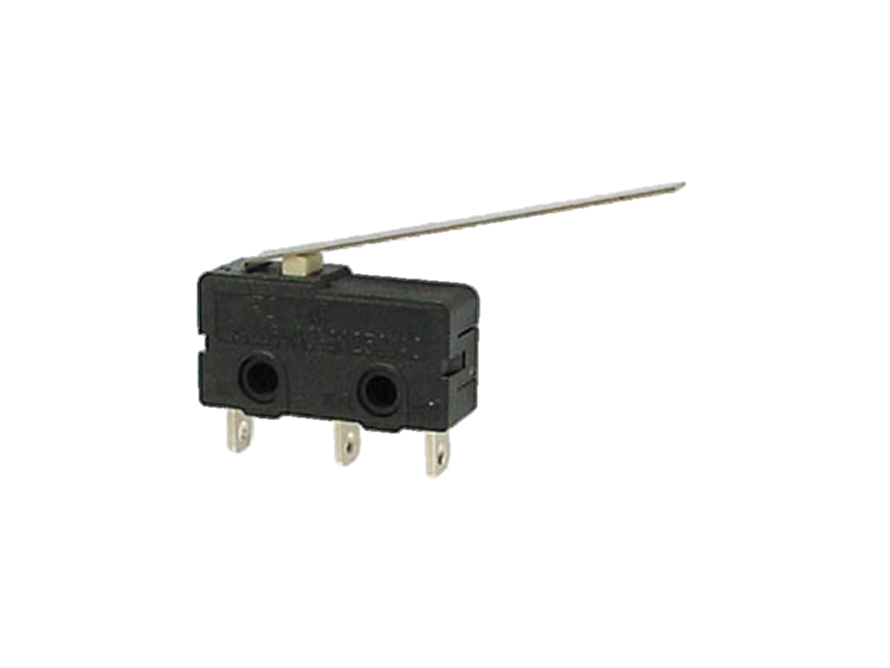

Slide 10
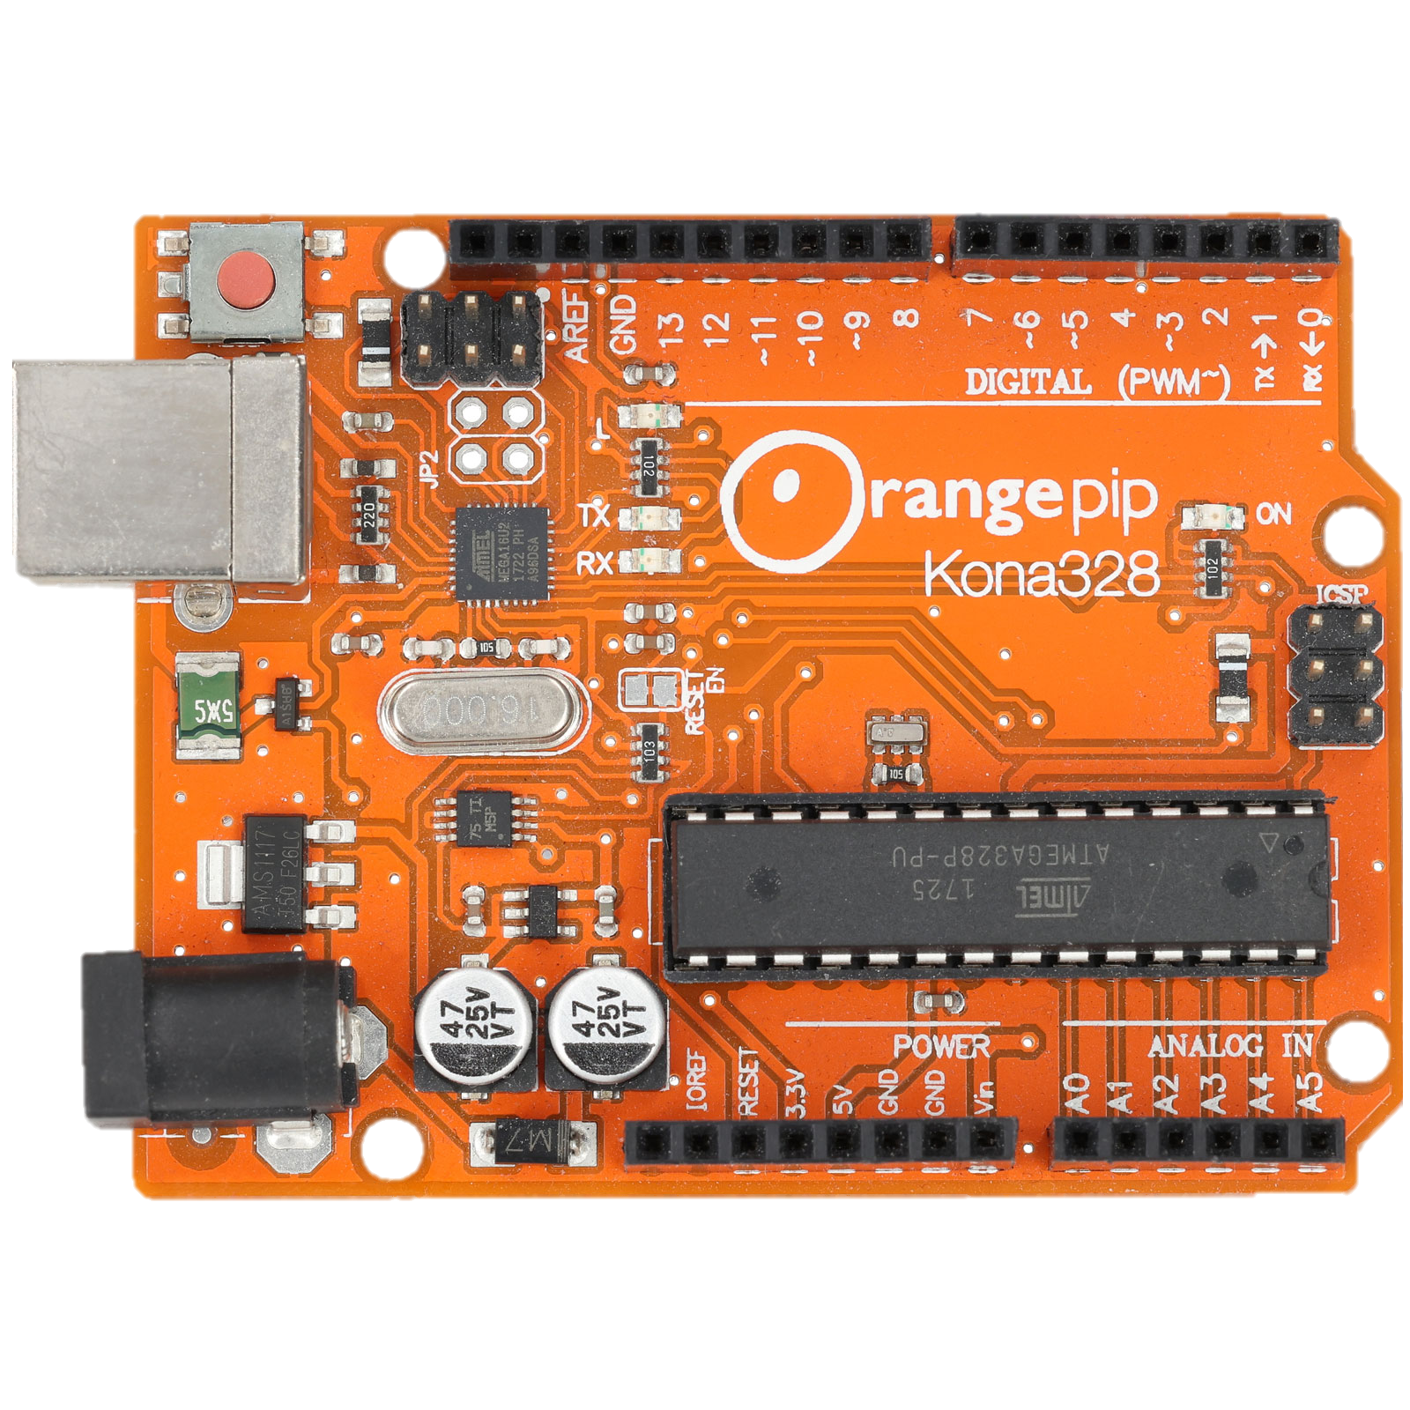

Slide 11
Microcontroller
Used to control electronics

Slide 13
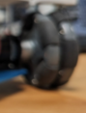

Slide 14
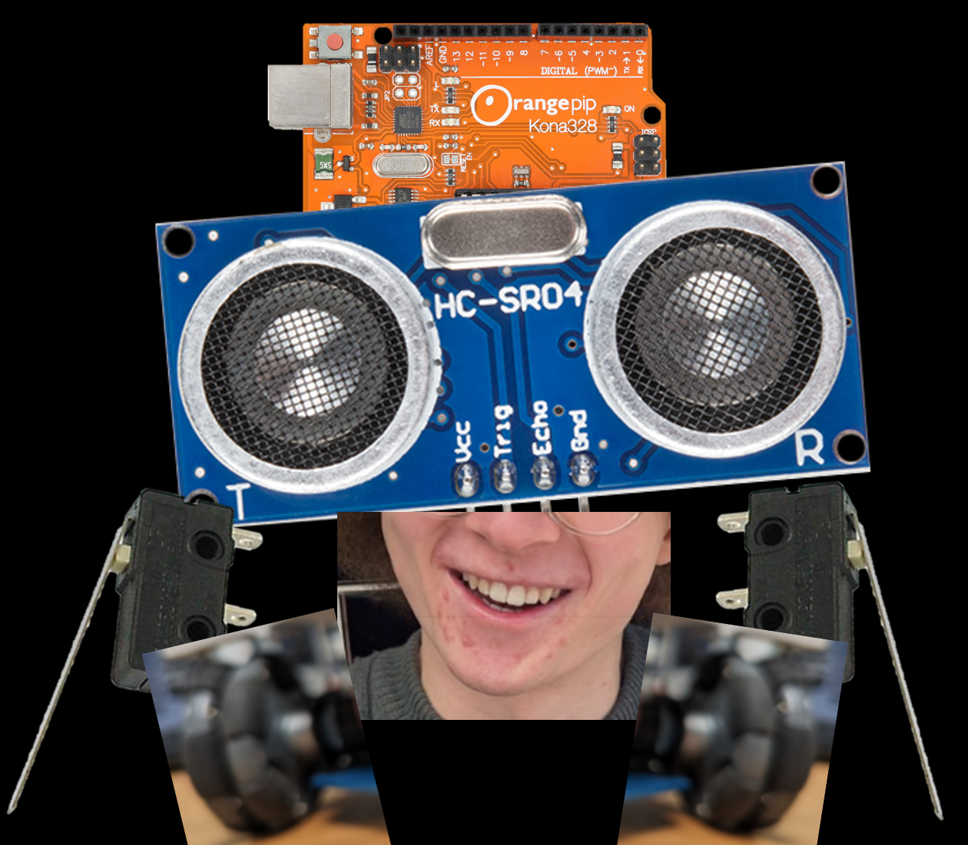
BRAIN = empty

Slide 15
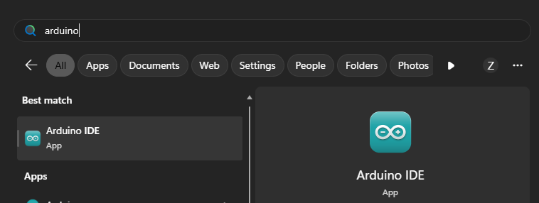

Slide 16
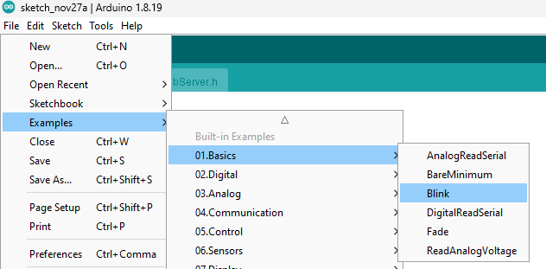







Slide 17
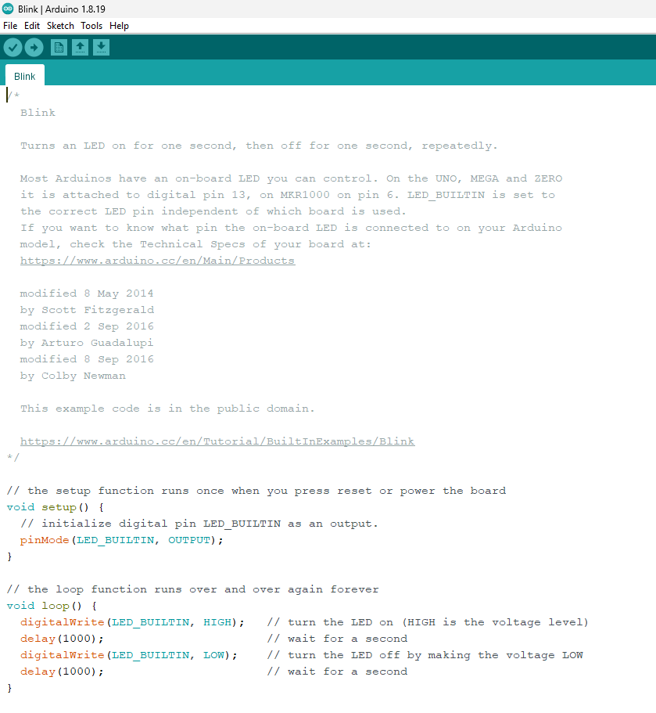

Slide 18
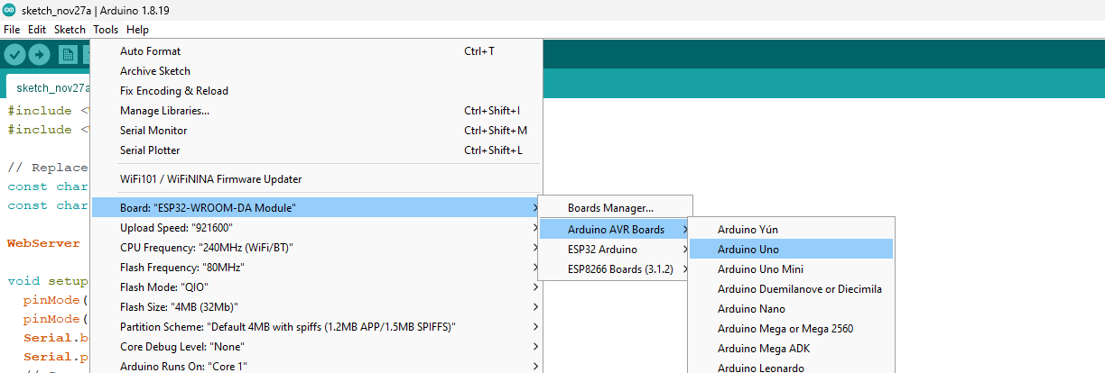







Slide 19
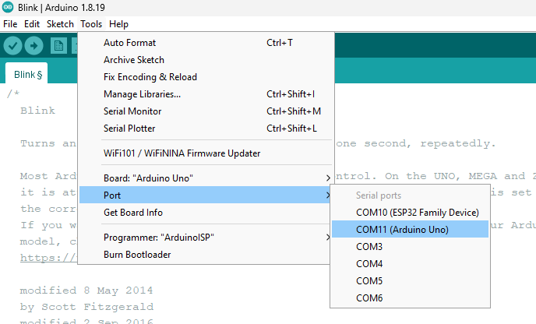






Slide 20
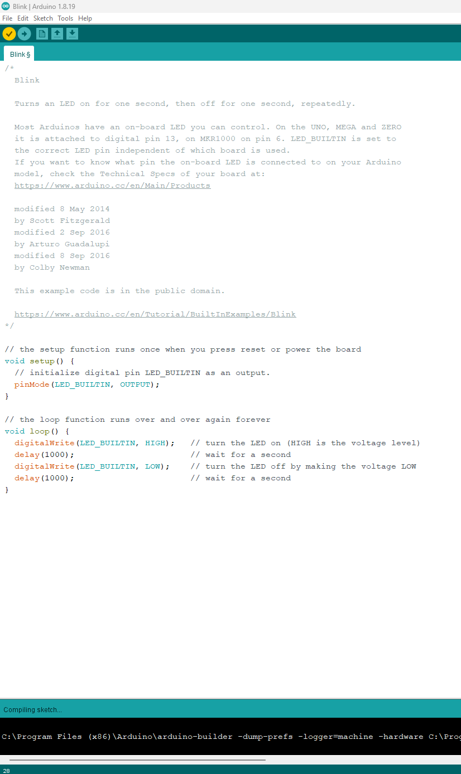
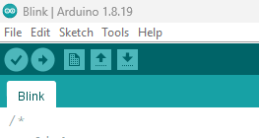







Slide 21
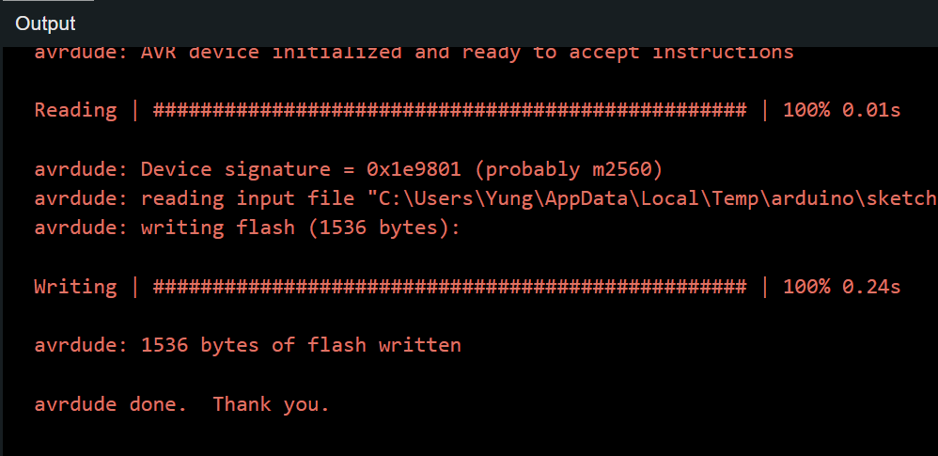


Slide 22














Slide 23
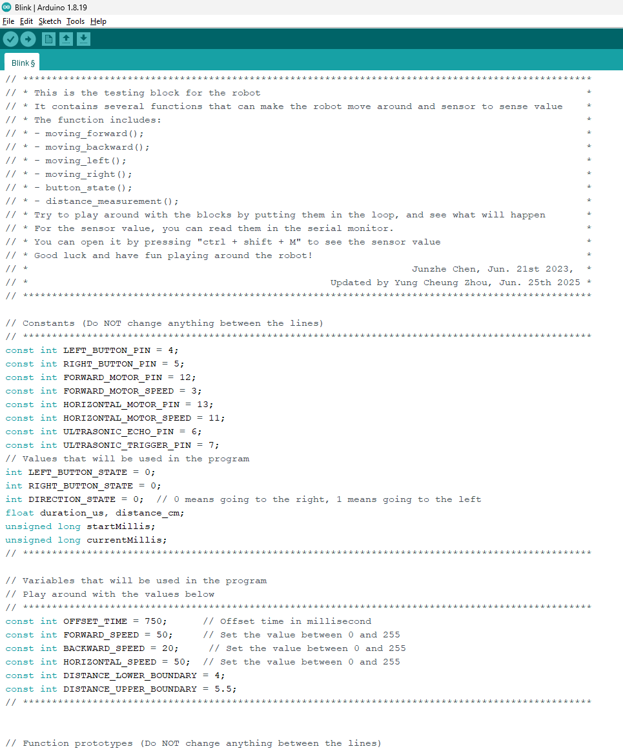
https://raw.flemingsociety.com/robot.txt
COPY ALL code (CTRL + A > CTRL + C)
Replace all code on Arduino (CTRL + A > CTRL + V)

Slide 24
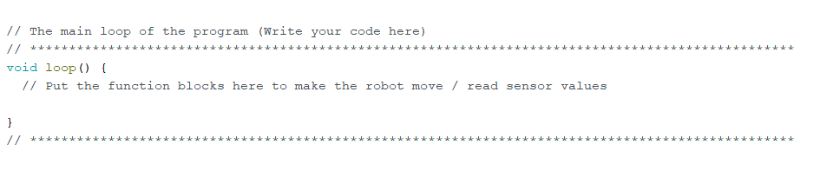
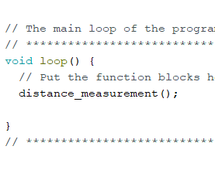
Find this
Type this: distance_measurement();

Slide 25






Slide 26
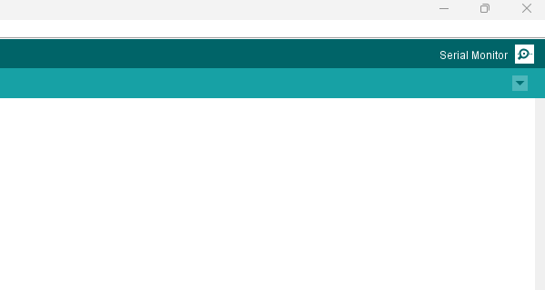



Slide 27
Now try : moving_forward();
moving_backward();
moving_left();
moving_right();
button_state();
distance_measurement();

Slide 28
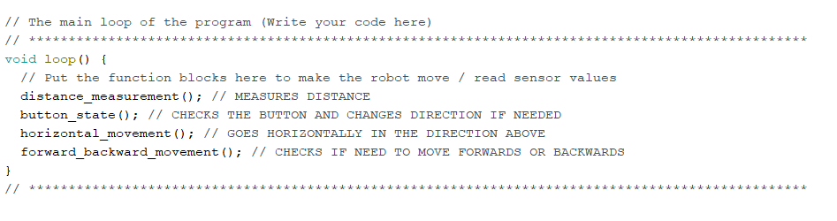
FINAL CODE

Slide 29
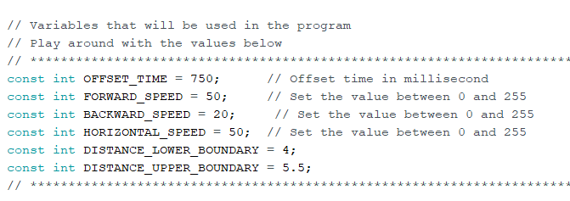
CHALLENGES
MOVE DIAGONALLY TO SOLVE THE MAZE FASTER
PRE-EMPTIVE DIRECTION DECISION MAKING
(change directions after going through a gap)
LEADERBOARD
STUCK ON A CORNER?
YOU’RE THE ENGINEER!
CHANGE THESE!
WINNER WINS A PRICE

